Slide 1

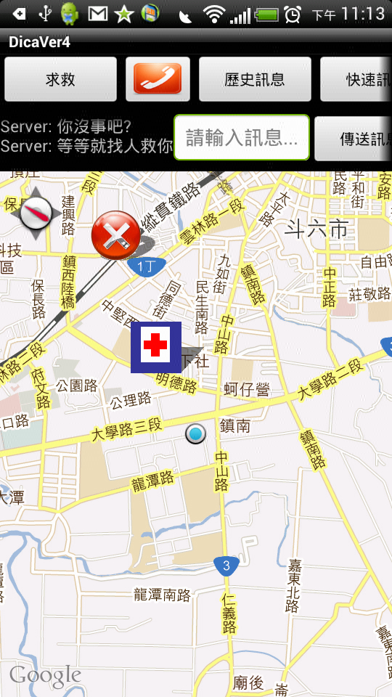
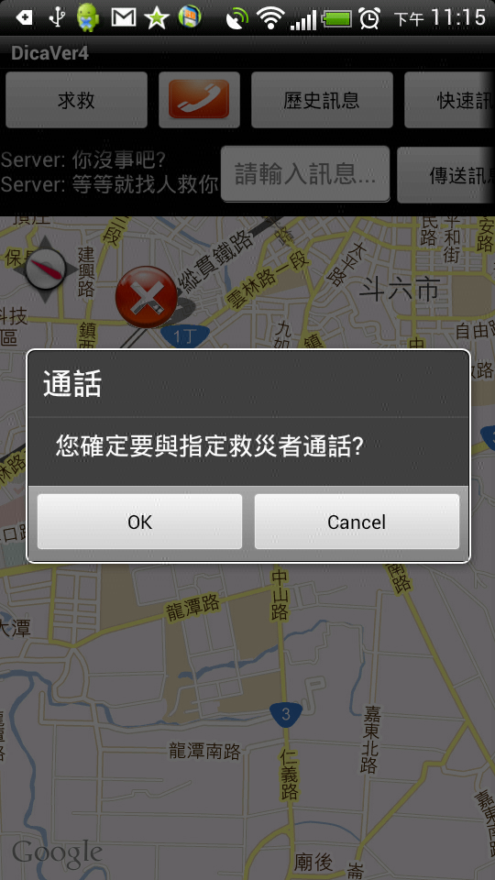
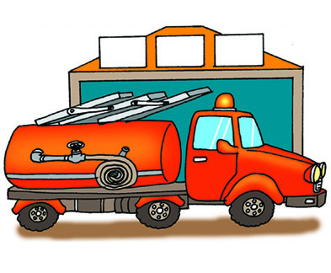
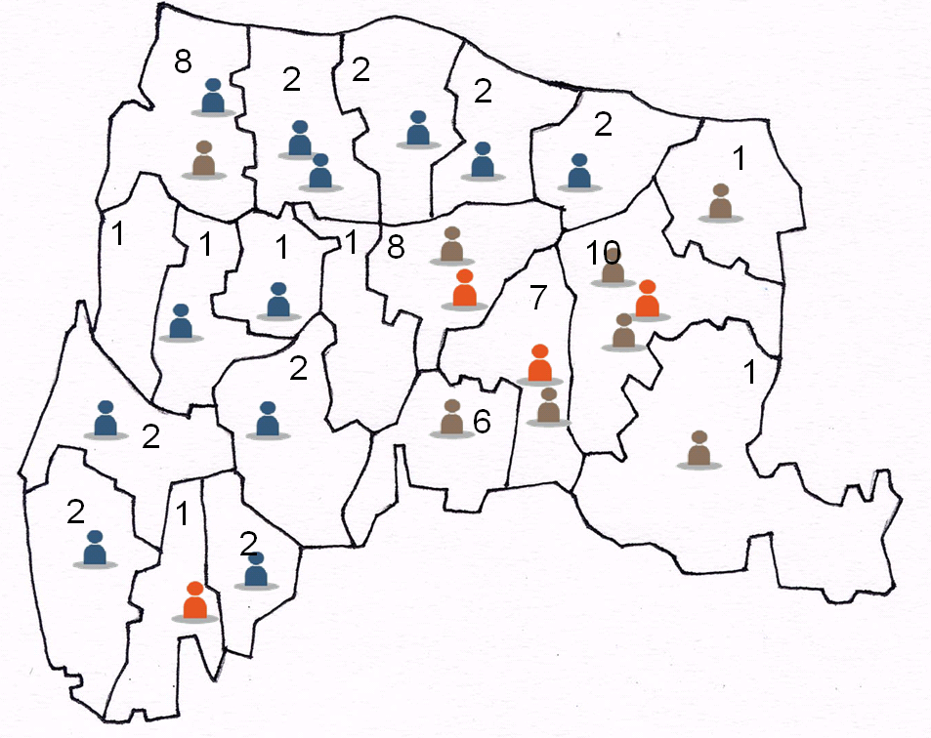

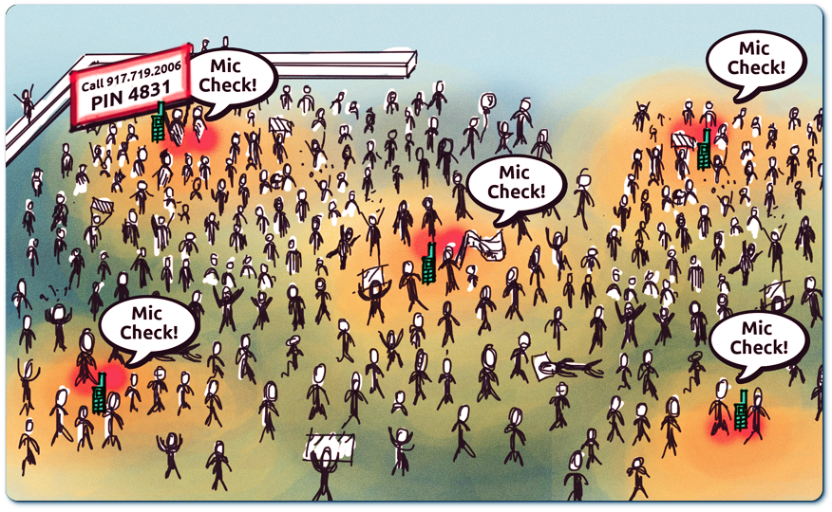
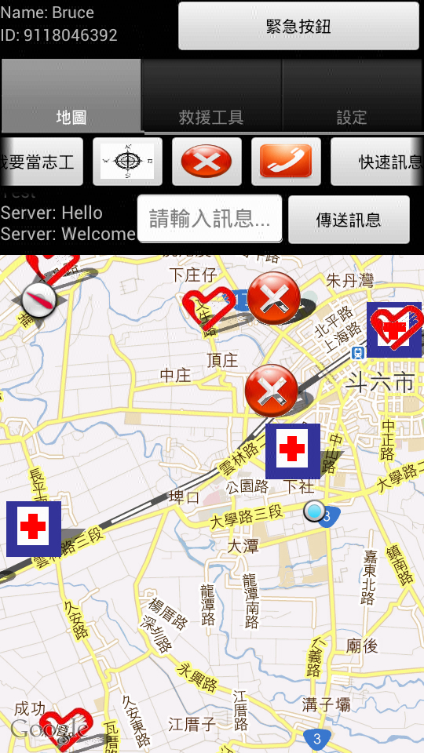
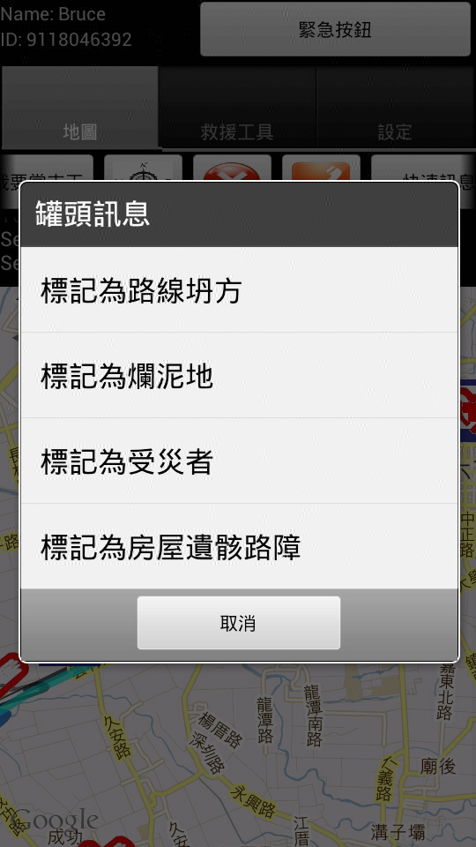
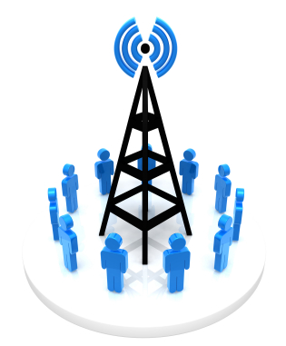





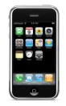
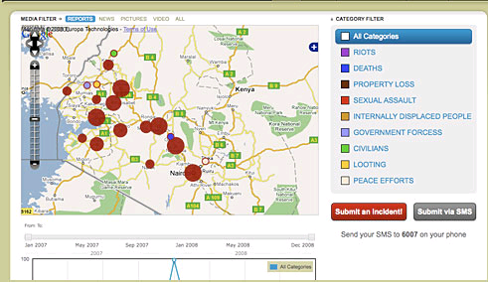
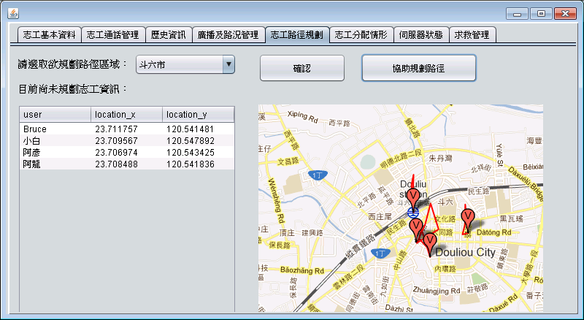
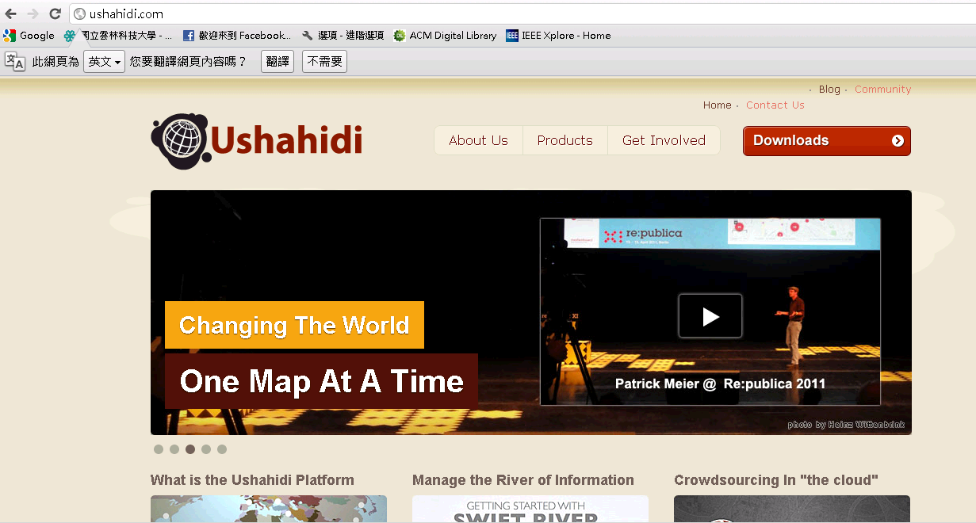
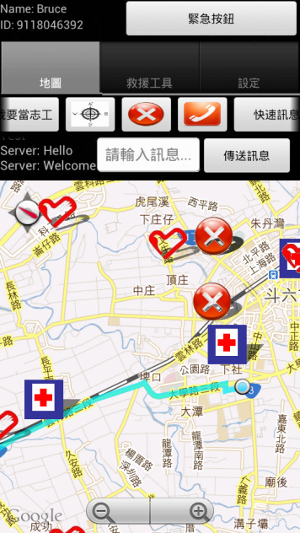
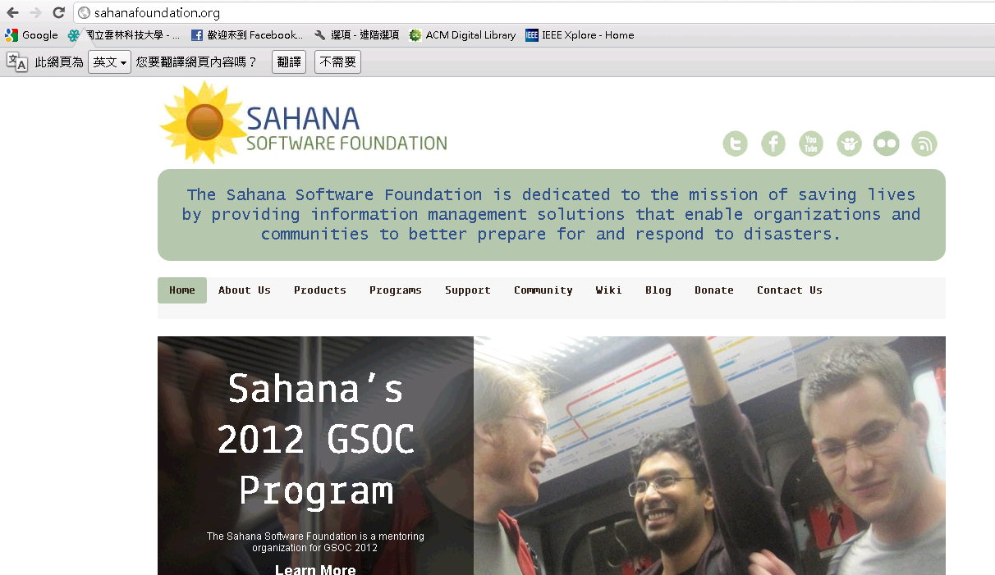


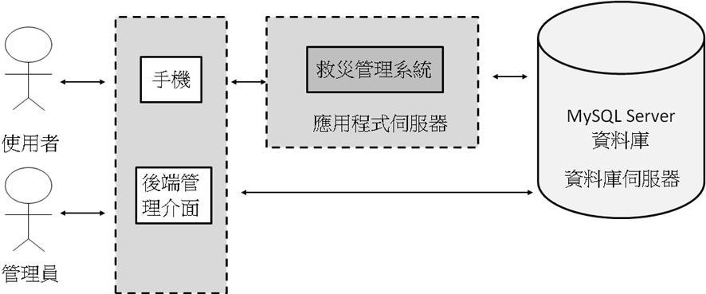



救災資訊輔助系統
(Disaster Information Aid System)
學生:白繕維、林俊佑、陳以龍
Motivation
Our Solution
User Interface
Traditional emergency response system may become congested during a major disaster, such as 2010 Haiti earthquake and Typhoon Morakot 2009, because of huge requests from victims. As a result, it is important to properly handle each emergency request during and after the disaster.
We develop the package of disaster rescue on the smart phone and build Web2.0 disaster management system on the desktop computer. We can distribute the human resource effectively through plan the path and offer Internet telephone for each participant.
Victims
！ ？ ？
Volunteers
System Flow
Victims
Existing Solution
Location
Crowd
Official Rescue
Experiences with past major disasters tell us that people with wireless devices and social network services can be effective mobile human sensors. Eye-witness reports taken at right locations can provide invaluable information and enable a disaster warning and response system to mend blind regions in surveillance sensor coverage. Ushahidi and Sahana are management systems that arrange these reports
Command Center
Path
Command Center
The victims send the request rescue message for command center
Broadcast a data collection request to a crowd and wait for the responds
The Web2.0 DMS distribute and determine an exploration path for each participant and official rescue
Each volunteer follows the path determined by the command center to explore the threatened areas
The communication between the system and the crowd repeats until the system has a complete view. They also assist victims rapidly through our Internet phone
Our Contribution
We convert the geography information in the phone and server.
We implement the streaming technology to improve the disaster rescue.
We offer the network monitor environment to control the users.
We develop the route algorithm to apply the disaster scenario.
We develop the assignment algorithm to apply the disaster scenario.
Platform Requirement
Crowdsourcing [1]
Software:
JAVA development environment(Eclipse, Netbeans)
Android Emulator
Window XP / Win 7
Hardware:
Common desktop computer
Smart phone
The transmission between the smart phone and computer
Limitation
Due to the advance of social network technology, crowdsourcing has been used in the disaster rescue. But existing disaster management system such as Ushahidi and Sahana, do not provide a method to manage these volunteers. We aim to built this project in order to access human resource such as volunteers, official rescues after a major disaster.
Conclusion
Taiwan faces many disasters every year, including typhoon, earthquake and so on. Traditional emergency response systems are usually congested during a major disaster. We proposed a Web 2.0 disaster information aid system to help victims directly contact with rescuers and plan the area and path for volunteers to assist the collect disaster condition. In the future, we plan to integrate our system into current official disaster management system.
Acknowledgement
This work was supported in part by Academia Sinica Taiwan under Grant AS-101-TP2-A01.
Reference
[1] ] http://www.adfero.com/wp-content/uploads/2010/11/Crowdsourcing.jpg

